Slide 1


To - Do
List
Presented By :
Sahil
L.J. University | 2024

Slide 2
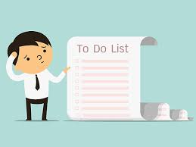
1
What is To-Do List ?
A to-do list is a simple organizational tool used to outline tasks or activities that need to be completed within a specific timeframe. It helps individuals prioritize their responsibilities and track their progress towards achieving their goals
L.J. University | 2024

Slide 3

2
How to use it ?
1
To use a to-do list effectively, start by listing all tasks you need to
complete, prioritizing them based on urgency
or importance
L.J. University | 2024
2
Break larger tasks into smaller, manageable steps for easier completion.
Allocate specific time slots or deadlines for each task, and regularly review
and update your list as needed.
3
Finally, check off tasks as you complete them to stay motivated and
focused on your goals.

Slide 4
3
functionality
Basic html css javascript
Edit and Remove option
Use of local storage
L.J. University | 2024

Slide 5
5
Merits
Reduced Stress
Prioritization
L.J. University | 2024
Productivity
Tracking Progress
Organization

Slide 6
5
Demerits
Overwhelm:
Neglect of Priorities
L.J. University | 2024
Procrastination
Dependency
Rigidity

Slide 7
L.J. University | 2024
Thank You !

